Slide 1
The Ear Training Program
By: Juan S. Piedra

Slide 2
Goals and Objectives
For this project I was interested in creating a tool that would help musicians memorize and understand intervals.
Ear training is a fundamental part of becoming a working musician since it helps with not only hearing music and being able to tell what it is immediately, but it helps with learning music much faster and helps improvisation as well.
My goal was to provide a program that plays the different types of intervals that exist within the chromatic scale and would allow the user to memorize them in different keys.

Slide 3
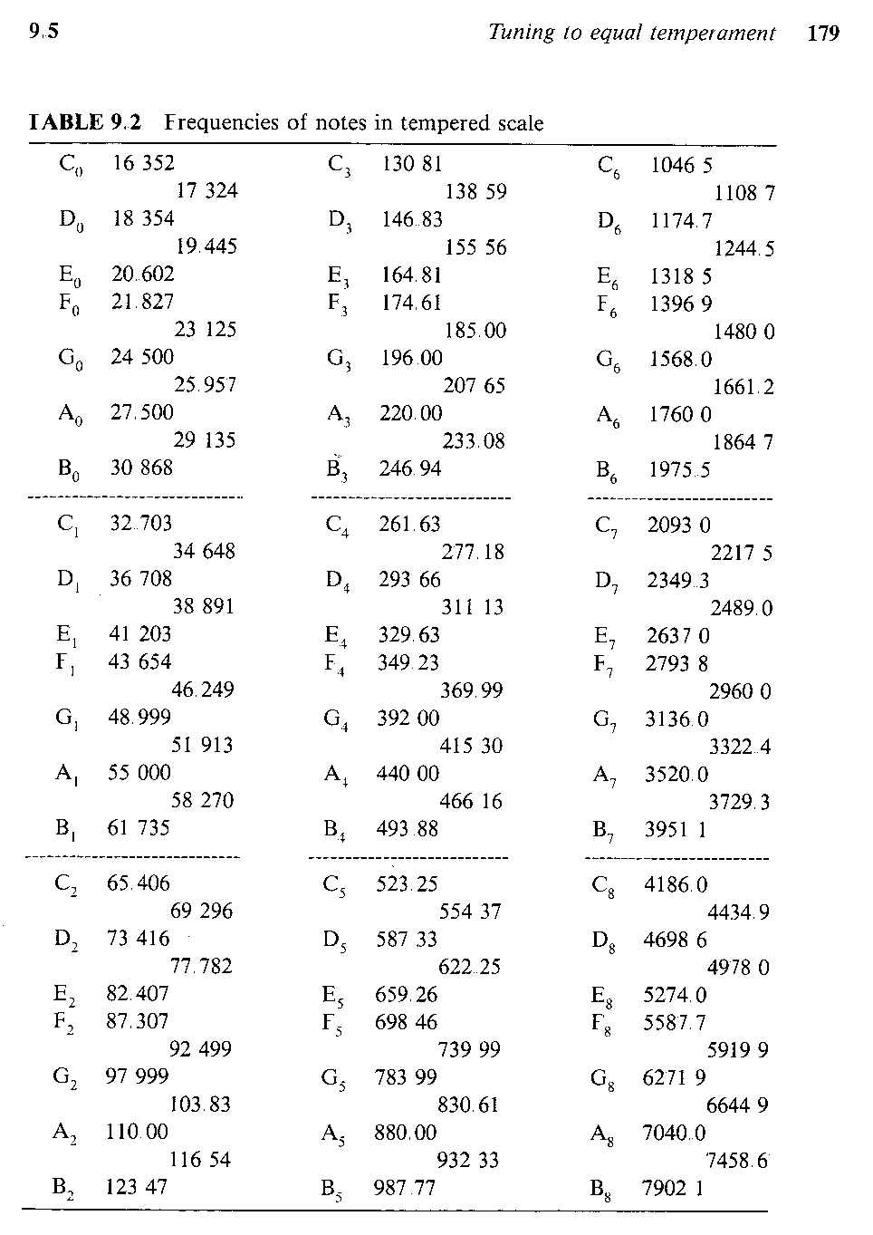
Workspace
In order to start building the code, I had to assign variables to certain frequencies that are assigned to each musical note within the chromatic scale.

Slide 4
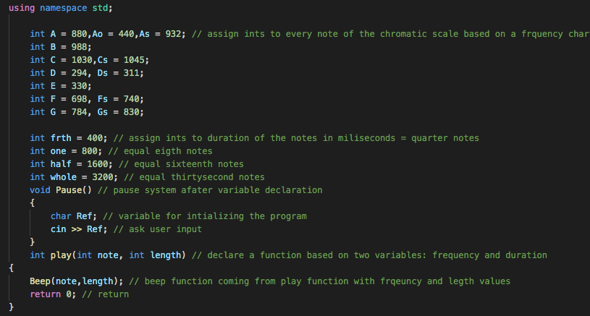
Building the Program
After assigning each variable to its frequency I create d apply function that read into the deep function. This allowed me to choose the frequency of the sound and the duration. This went out into the play function. I declared
Then I declared a couple of variables for the duration of the frequency. Each representing a note value staring from quarter notes to thirty second notes.

Slide 5
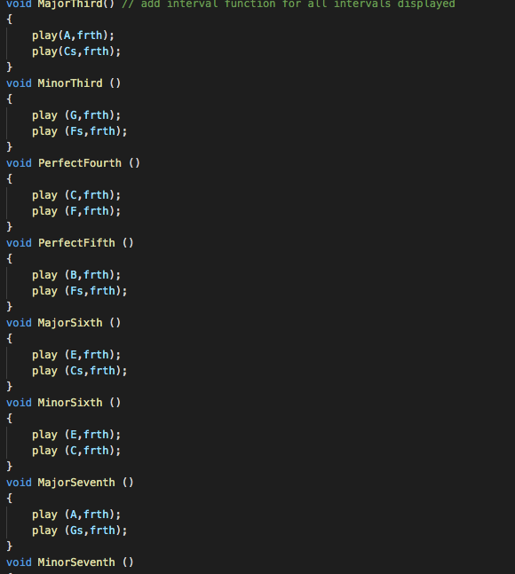
Building the Program
Following the path of the Beep function. I then created a separate function for each interval that I used and gave the option for the user to choose from.
Each interval was spread out across all twelve keys in order for the user to hear the interval quality as opposed to the notes in relation to a key.

Slide 6
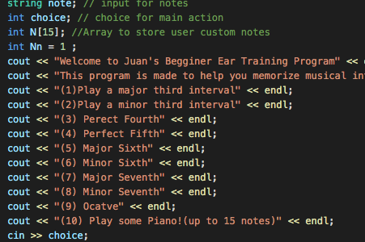
The Main Function
Inside the main function I declared a string corresponding to the note being played. This will be used later as a cin >>.
Inside the main function I created a menu that will display all the different choices the user gets and intervals to hear.
At the end I added an option for the user to play all of the notes individually.

Slide 7
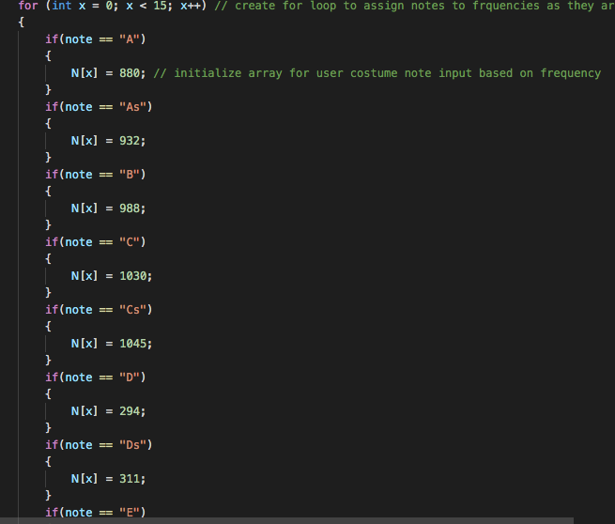
Looping and The User Piano
After the menu is displayed I created a while loop which has a if statement for every interval chosen.
Inside the for loop I created 15 input for the user to choose from starting at A = 880 Hz all the way to G# = 830.
In order to do this I initialized an array which will store the 15 custom inputs provided by the user.

Slide 8
Conclusion
Following the creation and coding of this project. I would say that I have had a much better understanding of program building and development. I was very glad that I could turn what I learned in class into something that relate into my everyday work as a musician and I would hope that this tool could be useful for other musicians as well.
I also found C++ to be a very interesting language to learn since it is one of the ways in which humans can actually communicate directly with a machine and sort of give it tasks in order to solve problems.

Slide 9
Thank You

